Slide 1
Unit 4- Lecture 26
Planning problem
Goal stack planning

Slide 2
Planning problem
A planning problem P is defined as a triple (S, G, O) where,
- S is set of facts completely describing the given or start state,
- G is a set of facts required to be true in a goal state, and
- O is the set of operators.
The above defines the simplest of planning problems. The simplest notion of a plan is a sequence of actions, each of which is an instance of some operator in O.

Slide 3
Valid plan
A sequence of actions Π = (a1, a2, ..., an) is a valid plan for a problem P, if a₁ is applicable in the state S, progressing to state S₁, a₂ is applicable in the resulting state S₁, and so on, yielding the state S_{n} after the action a_{n}, and G ⊆ Sn.
A simple linear time procedure may be written to verify that a plan Π = (a1, a2, ..., an) is a valid plan, by successively progressing through the sequence of actions and checking whether the final state contains the goal facts G.

Slide 4
ValidPlan(plan, state, goal)
if Empty(plan)
then if Satisfies(state, goal)
then return TRUE
else return FALSE
else state <- Progress(Head(plan), state)
return ValidPlan(Tail(plan), state, goal)
Given the function to check the validity of a plan, we can write a backward state space planning algorithm that will apply this check before termination.

Slide 6
Goal Stack Planning
The main problem with BSSP is that goal regression is not sound and the algorithm may be handling goal descriptions that are not consistent with any state.
The advantage of BSSP over FSSP is that because it focuses on the goal, the search space it generates is smaller due to the branching factor being lower.
FSSP, on the other hand, is sound but has a large branching factor, since it looks at modifications to the complete state.
One of the earliest planners STRIPS (Fikes, 1971) attempted to combine the focused search of BSSP with the soundness of FSSP.
It considered actions by reasoning in a backward manner, but committed itself to actions only in a forward manner.

Slide 7
The algorithm is also called Goal Stack Planning (GSP) because it pushes subgoals and actions into a stack, and picks an action only when all its preconditions are satisfied.
That way, it works with state descriptions that are always consistent for growing plans, and goal descriptions for growing the search tree.
The algorithm is however incomplete, in the sense that it could terminate without finding a plan.
It is possible that the algorithm could commit to a wrong action at some time, reaching a state from which a plan cannot be found.
For domains where the actions are reversible, for example the blocks world domain, the algorithm can be made complete by putting in an extra check, somewhat similar to the one in BSSP.

Slide 8
However, the reasons for introducing the check are different, as described below.
GSP breaks up a set of goal predicates into individual subgoals and attempts to solve them individually one after another.
This approach is also sometimes called linear planning.
This refers to the fact that the subgoals are attempted and solved in a linear orders.
When we implement BSSP with depth first strategy, we are in fact doing something similar.
In some domains, a subgoal solved earlier may get disrupted by later actions.
Most human solvers of the cube attempt it as a sequence of subgoals, but end up disrupting them on the way to the final solution.

Slide 9
In domains where the goal state is reachable from all states, one can tackle this problem of subgoal interaction by putting in a check to verify that all subgoals have indeed been solved before termination.
This check is necessary to take care of subgoal interaction, which is different from the check in BSSP, where it was to determine the validity of the plan constructed.
Goal Stack Planning works by pushing the goal description onto a stack.
It pushes both the conjunct, as well as each of the individual goal predicates separately.
The algorithm pops the element on the top of the stack.
If it is a (goal) predicate that is true in the current state then nothing is done and the next element is popped from the stack.

Slide 10
If it is a goal predicate that is not true in the current state, a relevant action is pushed onto the stack, followed by the preconditions—first the conjunction, and then the individual preconditions.
The precondition on the top of the stack becomes the next subgoal to be addressed recursively.
In practice, one may have to choose from a set of relevant actions that is pushed onto the stack.
In the algorithm described below, this is shown as a nondeterministic choice by a choose operator.
In practice, during implementation, this should be a choice point for a backtracking search algorithm which will try out different actions.

Slide 11
If all the preconditions of an action are true in a given state, they will get popped away, and the action will be on the top of the stack.
In this case, the action is popped and added to the partial plan being grown in a forward manner.
The current state progresses over the chosen action, and planning resumes by looking at the top of the stack.
If the stack becomes empty, all the goal predicates have been achieved, and a plan is returned.
If at any stage the planner cannot find an action to achieve a goal predicate, the algorithm reports failure.

Slide 12
We assume a function PushSet(Set, Stack) that takes a set of goal predicates and (a) pushes the conjunction of the predicates onto the Stack, and (b) also the individual goal predicates in some order.
This order may be determined heuristically if possible.
For example, in the blocks world domain, holding(Block) should be attempted last because it blocks up the robot arm.
If it is solved or achieved first then it could be undone while achieving some other subgoal, since the plan is for a one-armed robot.
The algorithm for GSP is shown below.
We assume, as is the case with many modern planners, that all instances of the planning operators that match the domain are available, is a set called actions.

Slide 14
Let us look at the trace of algorithm GSP on a small problem depicted in below figure. Let the initial state be:
S = {onTable(A), onTable(B), onTable(C), clear(A), clear(B), clear(C), armempty}

Slide 15
Let the final state be a tower of A, B and C expressed by {on(A, B), on(B, C)}.
Assume that we execute the algorithm GSP and keep a watch on the push and the pop actions, the plan being assembled, and the current state S as and when it changes.
Remember, that PushSet is a function that pushes the set onto the stack, first the conjunct of predicates, and then each one individually.
Let us assume that the trace shows us the object being pushed or popped, the plan whenever it is augmented, and the state after the most recent action is popped.
The trace of the algorithm will then look like in the next slide:

Slide 16
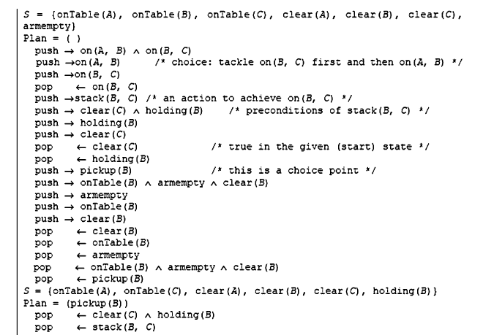

Slide 17
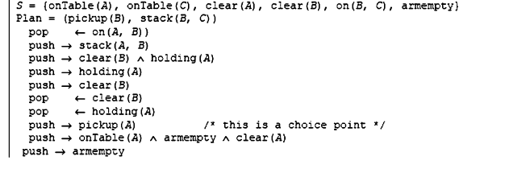

Slide 18
The reader would have noticed that the algorithm has made some choices in the above execution.
Choice points occur when there is more than one way of achieving a goal predicate.
For example, the above trace has to find actions to achieve the goal predicate holding(B).
This can be achieved either by picking up block B from the table, or by unstacking it from some other block.
Which block to unstack it from, would also be a choice point.
Likewise, if the robot is holding a block, and the goal predicate being addressed is armempty, it has to decide where to put that block.

Slide 19
One approach would be to introduce backtracking here.
Another would be to do some secondary reasoning to resolve this choice.
For example, one could look at the state to see which action would be appropriate.
In the example trace, this would tell us that since block B is on the table, one can assume that nothing will disturb it till the time comes for holding(B) to be made true, the correct action is pickup(B).
The choice can also be resolved by looking at the goal set.
If, for example, the robot is holding a block (say) M, and the goal has a predicate on(M, N) then a good way to achieve armempty would be to use the action stack(M, N).

Slide 20
A different kind of choice is concerned with the order of attempting subgoals.
By pushing the subgoals onto the stack one by one, the algorithm is serializing them.
The order in which you attempt subgoals is obviously going to affect performance.
In the given trace, the algorithm chose to solve for on(B, C) first.
This turned out to be a good choice, and after stacking B on C, the algorithm stacked A on B.
What if the order had been reversed?
The algorithm would have first stacked A on B to reach the state,
S = {onTable(B), onTable(C), clear(A), clear(C), on(A, B), armempty}.

Slide 21
Then to achieve on(B, C) it would need to stack B on C, for which it would need holding(B), for which it would have to pickup(B), for which it would have to achieve clear(B), for which it would have to unstack(A, B) and put it somewhere.
It would have thus undone the subgoal on(A, B) achieved earlier.
We have addressed this problem by adding the full goal conjunct in the stack.
After achieving on(B, C) the algorithm will reach the state S = {onTable(A), onTable(C), clear(A), clear(B), on(B, C), armempty) and again look at the conjunct on(A, B) ⋀ on(B, C).
At this point on(B, C) is true but not on(A, B).
Now it will pickup A and stack it on B to find the plan (pickup(A), stack(A, B), unstack(A, B) putdown(A), pickup(B), stack(B, C), pickup(A), stack(A, B)).

Slide 22
It did solve the problem, but found a suboptimal plan.
Another place that ordering is imposed is in the order in which the preconditions are pushed onto the stack.
For the action pickup(?X) the preconditions are onTable(?X), clear(?X) and armempty.
It makes sense to push armempty first, and hence tackle it later.
If armempty is addressed first then the second precondition will need to disrupt it because the robot arm has to be used anyway.
If for example clear(?X) is done last then that would be achieved by unstacking something from ?X, which would mean holding(? X) would be true and armempty would have got disrupted.
Likewise, the preconditions of stack(?X, ?Y) are holding(?X) and clear(?Y).

Slide 23
For a similar reason holding(?X) should be done later, and hence pushed first.
We can think of the GSP algorithm as doing depth first search on an AND/OR goal tree.
Pushing into the stack is like generating the tree.
A goal predicate is solved if it occurs in the current state.
An action node (AND node) is solved if all its children (preconditions of the action) are solved.
An OR node represents a choice of actions for achieving a goal predicate.
The theorem proving algorithm searches for supporting statements in the backward direction, but commits to inferences in the forward direction.

